Slide 1
GROUP 1
ALZHEIMER’S DISEASE DIAGNOSIS USING
MACHINE LEARNING
Angel Priscilla Salim - 2602055281
Winanda Hartadi - 2602117866
Computational Biology

Slide 2
TABLE
of contents
01. Abstract
05. Evaluation Metrics
02. Literature Review
06. Introduction (Paper)
03. State-Of-The-Art
07. Workflow Method
04. Dataset
08. Code + Result

Slide 3
Abstract
Alzheimer’s Disease (AD) is a progressive mental deterioration and incurable neurodegenerative disease, responsible for 60-70% of dementia cases. In addition, Alzheimer’s Disease is known as the fifth-leading cause of death among elderly population. As the global population ages, the prevalence of Alzheimer’s disease is expected to rise significantly, posing a considerable burden on healthcare systems and society as a whole. The objective of this research study is to propose a state-of-the-art and the implementation of various machine learning models to predict Alzheimer’s Disease from a MRI dataset of normal and diseased subject.

Slide 4
Literature Review
1
Comparing Different Algorithms For The Course of Alzheimer’s Disease Using Machine Learning
2021
Xiaomu Tang, Jie Liu
https://apm.amegroups.org/article/view/76527/html
2
A Comprehensive Study on Early Alzheimer’s Disease Detection Through Advanced Machine Learning Techniques on MRI Data
2023
Qunwei Lin, Chang Che, Hao Hu, Xinyu Zhao, Shulin Li
https://drpress.org/ojs/index.php/ajst/article/view/14334

Slide 5
State-Of-The-Art
The most used methods are Random Forest (RF) algorithm and Support Vector Machine algorithm. Both methods are used to classify brain MRI images into few groups, including Alzheimer’s Disease (AD) group and Normal Control (NC) group. Random Forest algorithm is an ensemble learning technique combining numerous classifiers to enhance a model’s performance. Support Vector Machine is a supervised max-margin models with associated learning algorithms that analyze data for classification and regression analysis

Slide 6
Dataset
ADNI
The Alzheimer’s Disease Neuroimaging Initiative unites researchers with study data to define the progression of Alzheimer’s Disease. ADNI researchers collect, validate and utilize data, including MRI and PET images, genetics, cognitive tests, CSF and blood biomarkers as predictors of the disease.
OASIS
The Open Access Series of Imaging Studies is a project aimed at making neuroimaging data sets of the brain freely available to the scientific community by compiling and freely distributing neuroimaging data sets.

Slide 7
Evaluation Metrics
Accuracy
Sensitivity
Precision
Accuracy refers to how often a machine learning model correctly predicts the outcome
Sensitivity is the metric used to evaluate a model’s ability to predict true positives of each available category.
Precision is used to evaluate the performance of a classifier model.

Slide 8
Introduction
In recent years, there has been growing interest in leveraging machine learning (ML) techniques to improve the accuracy and efficiency of Alzheimer’s disease diagnosis. Machine learning algorithms have the potential to analyse vast amounts of heterogeneous data, including clinical assessments, neuroimaging data (such as magnetic resonance imaging (MRI), positron emission tomography (PET), and cerebrospinal fluid (CSF) biomarkers), genetic information, and even wearable sensor data, to identify patterns and biomarkers indicative of Alzheimer’s disease.

Slide 9
Introduction
Currently, diagnosing Alzheimer’s disease relies heavily on clinical evaluation, which includes cognitive tests, medical history assessment, and neuroimaging scans. However, these methods can be subjective, time-consuming, and costly, often leading to delayed diagnosis and treatment initiation. Moreover, the accuracy of clinical diagnosis, particularly in the early stages of the disease, remains a significant challenge, with misdiagnosis rates reported to be as high as 30-40%.

Slide 10
Introduction
Convolutional neural networks (CNN) are a class of deep learning algorithms that have gained popularity recently, and emerged as effective tools for analyzing medical imaging data and diagnosing various diseases, including Alzheimer's Disease. CNN are particularly well-suited for image identification and classification tasks due to their ability to automatically learn hierarchical features from raw or unprocessed data. CNN architectures like ResNet50, ResNet152, DenseNet, and EfficientNetB7 have been successfully applied in medical imaging tasks.

Slide 11
Introduction
In our research, we aim to compare the accuracy rates of these CNN-based architectures for early prediction of AD. By comparing their performance on benchmark datasets and clinical data, we seek to identify the most effective approach for AD diagnosis. The ultimate goal is to develop a reliable and efficient tool for early detection of AD, enabling timely intervention and personalized treatment strategies. Through our investigation, we contribute to advancing the field of machine learning-based diagnosis of AD and improving patient outcomes in clinical practice.

Slide 12
Implementation of
Machine Learning Methods
Data Collection
Performance Evaluation
Workflow Method
Data Pre-processing
MRI Image Classification
Notes:
Data Collection
In the data collection stage, we gather the data that we will use to train our machine learning model. This data can come from a variety of sources, such as surveys, sensors, or databases.
It's important to collect high-quality data that is relevant to the task we want our model to perform.
Implementation of Machine Learning Methods
Once we have collected our data, we can start to implement our machine learning model. This stage involves choosing an appropriate machine learning algorithm, training the model on our data, and then evaluating its performance.
There are many different machine learning algorithms available, and the best choice for a particular task will depend on the specific problem we are trying to solve.
Performance Evaluation
After we have trained our machine learning model, we need to evaluate its performance. This involves testing the model on a new dataset of data that it has not seen before.
By evaluating the model's performance, we can determine how well it is generalizing to unseen data.
Conclusion
By following these three stages, we can develop effective machine learning models that can be used to solve a wide variety of problems.

Slide 13
Code
import numpy as np
from tensorflow.python.keras import layers
from tensorflow.python.keras.layers import Input, Add, Dense, Activation, ZeroPadding2D, Flatten, Conv2D, AveragePooling2D, MaxPooling2D, GlobalMaxPooling2D
from tensorflow.python.keras.models import Model, load_model
from tensorflow.python.keras.initializers import glorot_uniform
Import Statements: Brings in necessary libraries:
numpy: For numerical and array operations.
tensorflow.python.keras...: Access to layers and components for building neural networks from the TensorFlow/Keras framework.

Slide 14
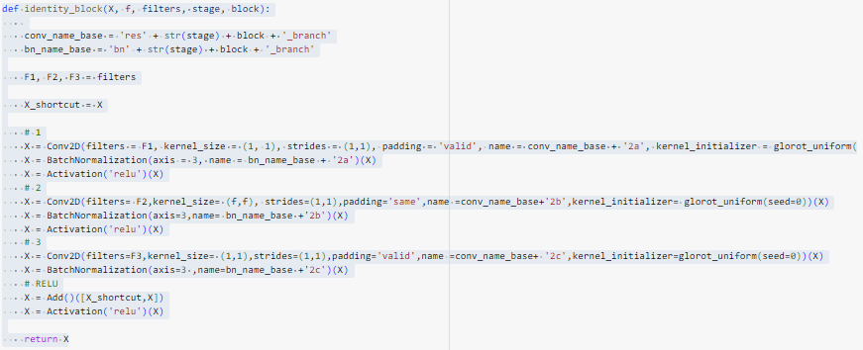
Code
Identity Block ( identity_block)
Core building block of ResNet architectures.
Implements "skip connections" where the input is added to the output of a series of convolutions. This helps with gradient flow in very deep networks.

Slide 15
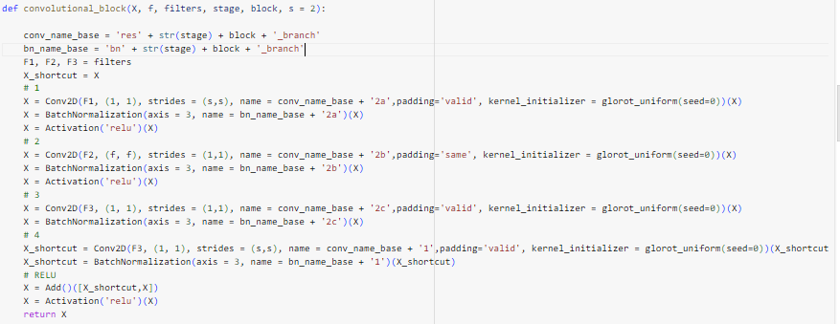
Code
Convolutional Block ( convolutional_block)
Another building block used in ResNets.
Includes skip connections and often a convolutional layer with stride = 2 to downsample the input.

Slide 16
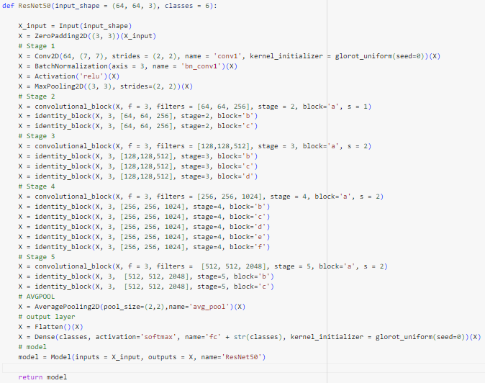
Code
(ResNet50)
ResNet50 Function (ResNet50)
Defines the overall ResNet50 architecture.
Stages:
Stage 1: Initial convolution and max pooling.
Stages 2-5: Sequences of convolutional and identity blocks, progressively increasing the number of filters and downsampling feature maps.
AVGPOOL: Global average pooling layer to reduce spatial dimensions.
Output Layer: Dense layer with softmax activation to produce the final class probabilities.

Slide 17
Code
Model Creation and Compilation
Creates the model (ResNet50), defining input shape and number of classes.
Compiles the model with:
'adam' optimizer
'categorical_crossentropy' loss (for multi-class classification)
'accuracy' metric

Slide 18
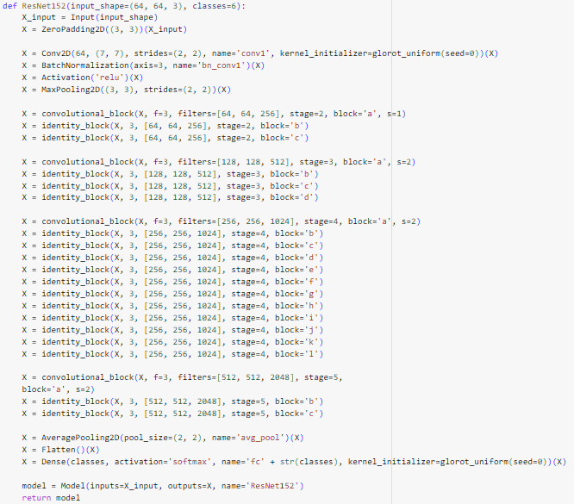
Other Model (Resnet152)

Slide 19
Depth:
ResNet50: Has a total of 50 convolutional layers organized into its various blocks.
ResNet152: Substantially deeper with 152 convolutional layers. This increased depth is the primary distinguishing factor between the two.
Blocks and Layers:
ResNet50: Stages 2-5 contain fewer repetitions of identity blocks compared to ResNet152.
ResNet152: Includes significantly more residual blocks overall. For example, Stage 4 in ResNet152 has a sequence of 12 identity blocks, whereas ResNet50 only has 6.
Computational Complexity:
ResNet152: Due to the greater depth, ResNet152 has a higher computational cost. It requires more parameters, leading to longer training times and increased memory consumption.
Performance Potential:
ResNet50: Often suitable for many image classification tasks, providing a balance between accuracy and efficiency.
ResNet152: The increased depth can potentially lead to higher accuracy on very complex image datasets (like ImageNet). However, this comes at the cost of computational resources and the risk of overfitting on smaller datasets.
Overfitting:
ResNet152: The greater number of parameters in ResNet152 makes it more prone to overfitting, especially if your dataset isn't sufficiently large and diverse.

Slide 20
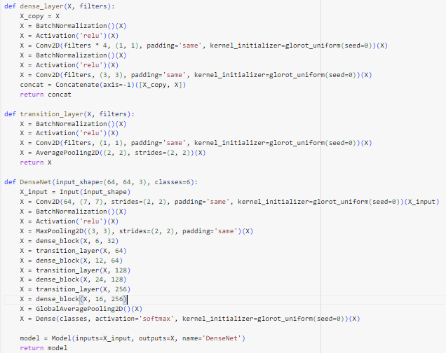
Other Model (DenseNet)

Slide 21
Core Concept:
ResNet50: Emphasizes skip connections with identity mappings. These skip connections allow direct flow of information and gradients across layers, mitigating the vanishing gradient problem in very deep networks.
DenseNet: Focuses on dense connectivity. Each layer receives input from all preceding layers and passes its own output to all subsequent layers within a dense block. This promotes feature reuse and strengthens feature propagation.
Architecture:
ResNet50: Built with a series of residual blocks (identity and convolutional blocks), progressively downsampling feature maps.
DenseNet: Employs dense blocks, where layers are densely concatenated. Transition layers with downsampling are used between dense blocks.
Information Flow:
ResNet50: Skip connections add the output of previous layers to the current layer's output.
DenseNet: Layers concatenate the outputs of all previous layers to their current input. This creates a wider flow of information with each subsequent layer.
Benefits and Drawbacks:
ResNet50: Effective at handling vanishing gradients, well-suited for very deep networks.
DenseNet: Exhibits strong feature reuse and can be more parameter-efficient than ResNets. However, the dense connections can lead to high memory consumption.

Slide 22
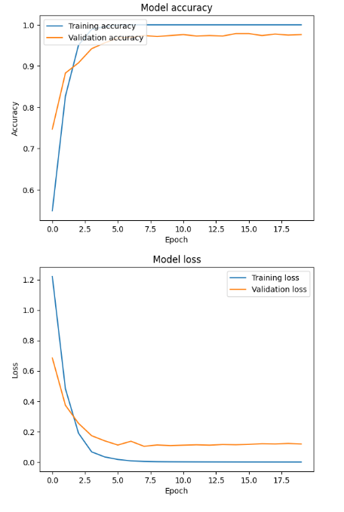
Other Model (DenseNet)
Plot Graphs for accuracy and losses in the DenseNet model.

Slide 23
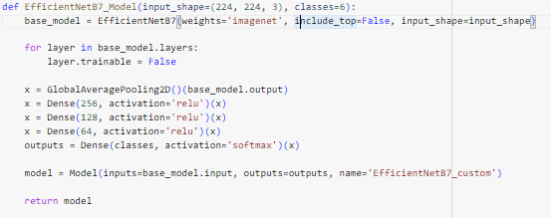
Other Model (EfficientNetB7)

Slide 24
1. Base Architecture:
ResNet50: Built from scratch using a series of custom-defined convolutional and identity blocks.
EfficientNetB7: Leverages a pre-trained EfficientNetB7 model as its foundation. EfficientNet models are known for carefully scaling depth, width, and resolution to achieve excellent accuracy with fewer parameters.
2. Transfer Learning:
ResNet50: Trained entirely on your dataset from randomly initialized weights.
EfficientNetB7: Employs transfer learning. It uses weights from the ImageNet dataset and then fine-tunes them for your specific task. This often speeds up training and can boost performance, especially with smaller datasets.
3. Trainable Layers:
ResNet50: All layers are typically trained during the process.
EfficientNetB7: Freezes the majority of the pre-trained EfficientNetB7 layers (layer.trainable = False). Only the newly added top layers (Dense layers) are trained on your dataset.
4. Customizability:
ResNet50: Provides full control over the network's architecture, allowing you to modify the depth, the number of filters, and block types.
EfficientNetB7: Offers less direct control over the core architecture, as you are primarily modifying the final classification head.
The EfficientNetB7 approach leverages a powerful pre-trained model and applies transfer learning to adapt it to your classification problem. This often leads to faster training and potentially better results. ResNet50, on the other hand, provides more flexibility for building a fully customized architecture from the ground up.

Slide 25

Results
(EfficientNetB7)
from tensorflow.keras.models import load_model
from tensorflow.keras.preprocessing import image
import numpy as np
def preprocess_image(img_path, target_size):
img = image.load_img(img_path, target_size=target_size)
img_array = image.img_to_array(img)
img_array = np.expand_dims(img_array, axis=0)
return img_array
model = load_model('/content/saved_model')
target_size = (64, 64)
uploaded_img_path = '/content/drive/MyDrive/test_image_moderatedemented.jpg'
preprocessed_img = preprocess_image(uploaded_img_path, target_size)
predictions = model.predict(preprocessed_img)
predicted_class_index = np.argmax(predictions)
predicted_class = classes[predicted_class_index]
print(f"Predicted class: {predicted_class}")

Slide 26
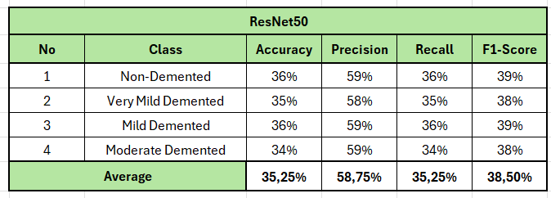
Result
The simulations conducted using ResNet50 architecture achieved an average accuracy of 35.25%, average precision of 58.75%, average recall of 35.25%, and average F1-score of 38.50%
Notes:
This is the simulations we conducted using a ResNet50 deep convolutional neural network architecture to classify images from a medical dataset. ResNet50 is a powerful image classification model known for its ability to handle deep network architectures.
Average Accuracy:
The simulations achieved an average accuracy of 35.25%. This means that on average, the model was able to correctly classify 35.25% of the images in the test dataset.
We also evaluated the model using precision, recall, and F1-score metrics.
Precision indicates the proportion of positive predictions that were truly positive.
Recall reflects how many relevant cases were identified by the model.
F1-score is a harmonic mean between precision and recall, providing a balanced view of these two metrics.
The average precision for the simulations was 58.75%, while the average recall was 35.25%. The average F1-score was 38.50%.

Slide 27
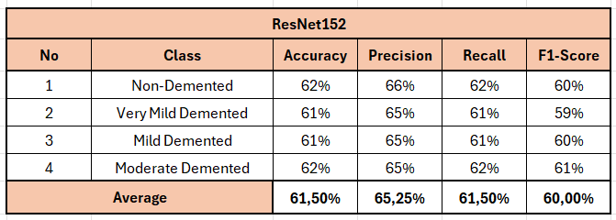
Result
The simulations conducted using ResNet152 architecture achieved an average accuracy of 61.50%, average precision of 65.25%, average recall of 61.50%, and average F1-score of 60.00%
Notes:
This is the simulations we conducted using a ResNet152 deep convolutional neural network architecture to classify images from a medical dataset.
Accuracy:
The simulations achieved an average accuracy of 61.50%.
The average precision for the simulations was 65.25%, while the average recall was 61.50%. The average F1-score was 60.00%.

Slide 28
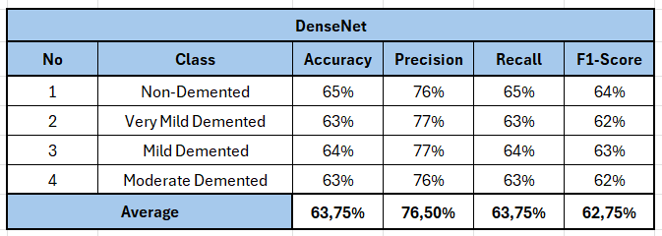
Result
The simulations conducted using DenseNet architecture achieved an average accuracy of 63.75%, average precision of 76.50%, average recall of 63.75%, and average F1-score of 62.75%
Notes:
Next one is thesimulations we conducted used a DenseNet deep convolutional neural network architecture to classify images from a dataset.
Average Performance:
The simulations achieved an average accuracy of 63.75%. This means that on average, the model was able to correctly classify 63.75% of the images in the test dataset.
Precision was 76.50%, indicating that out of all positive predictions made by the model, 76.50% were truly positive.
Recall was 63.75%, signifying that the model captured 63.75% of the relevant cases in the dataset.
The F1-score of 62.75% represents a harmonic mean between precision and recall, providing a balanced view of these two metrics.

Slide 29
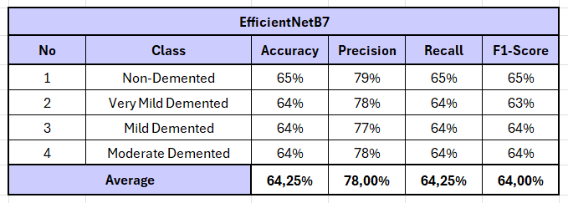
Result
The simulations conducted using EfficientNetB7 architecture achieved an average accuracy of 64.25%, average precision of 78.00 %, average recall of 64.25%, and average F1-score of 64.00%
Notes:
The last is the simulations we conducted used an EfficientNetB7 deep convolutional neural network architecture to classify images. EfficientNetB7 is a pre-trained model known for its ability to achieve high accuracy with relatively fewer parameters.
Average Accuracy:
The simulations achieved an average accuracy of 64.25%. This means that on average, the model was able to correctly classify 64.25% of the images in the test dataset.
The average precision for the simulations was 78.00%, while the average recall was 64.25%. The average F1-score was 64.00%.

Slide 30
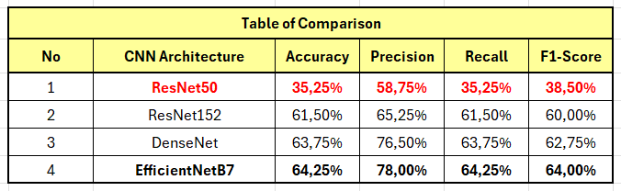
Conclusion
The highest accuracy was achieved by EfficientNetB7 architecture model with the average accuracy of 64.25%, average precision of 78.00 %, average recall of 64.25%, and average F1-score of 64.00%. The lowest accuracy was achieved by ResNet50 with the average accuracy of 35.25%, average precision of 58.75%, average recall of 35.25%, and average F1-score of 38.50%.
Notes:
In this presentation, we explored the performance of four deep convolutional neural network architectures for image classification: ResNet50, ResNet152, DenseNet, and EfficientNetB7.
Accuracy:
EfficientNetB7 achieved the highest average accuracy of 64.25%, followed by DenseNet (63.75%), ResNet152 (61.50%), and ResNet50 (35.25%).
Precision, Recall, and F1-Score:
EfficientNetB7 again achieved the highest average precision (78.00%) and F1-score (64.00%). While DenseNet had a similar F1-score (62.75%), EfficientNetB7 demonstrated a significant advantage in precision (78.00% vs 76.50% for DenseNet). ResNet152 had moderate precision (65.25%) and F1-score (60.00%), while ResNet50 exhibited the lowest precision (58.75%) and F1-score (38.50%) among the four models.
In terms of recall, all models achieved similar performance, with EfficientNetB7 (64.25%), DenseNet (63.75%), and ResNet152 (61.50%) having a slight edge over ResNet50 (35.25%).
Key Observations:
EfficientNetB7 emerged as the strongest performer across all metrics (accuracy, precision, recall, and F1-score). This is likely due to its ability to achieve high accuracy with a relatively low number of parameters, potentially making it more efficient to train and deploy compared to deeper models like ResNet152.
ResNet152 achieved better accuracy than ResNet50, demonstrating the benefit of increased depth for this image classification task. However, it did not outperform EfficientNetB7 or DenseNet in terms of precision and F1-score.
DenseNet offered a competitive performance with accuracy and F1-score close to EfficientNetB7. However, EfficientNetB7 surpassed DenseNet in precision.
ResNet50 lagged behind the other models in most metrics. This could be due to its shallower architecture compared to the other models.

Slide 31
ATTACHMENTS
Important Links
01. Paper
05. Code (EfficientNetB7)
02. Code (ResNet50)
06. Video (Youtube)
03. Code (ResNet152)
07. Video (Google Drive)
04. Code (DenseNet)
08. Literature Review

